Slide 1


CMSC 471
Constraint Satisfaction Problems
Instructor: KMA Solaiman
These slides were created by Dan Klein and Pieter Abbeel at UC Berkeley. [ai.berkeley.edu]
Notes:
Please retain proper attribution, including the reference to ai.berkeley.edu. Thanks!

Slide 2


Constraint Satisfaction Problems
Standard search problems:
State is a “black box”: arbitrary data structure
Goal test can be any function over states
Successor function can also be anything
Constraint satisfaction problems (CSPs):
A special subset of search problems
State is defined by variables X_{i} with values from a domain D (sometimes D depends on i)
Goal test is a set of constraints specifying allowable combinations of values for subsets of variables
Simple example of a formal representation language
Allows useful general-purpose algorithms with more power than standard search algorithms
Notes:
Goal test has structure, it ‘s more like a manual describing a set of constraints that have to hold true

Slide 3
CSP Examples

Slide 4


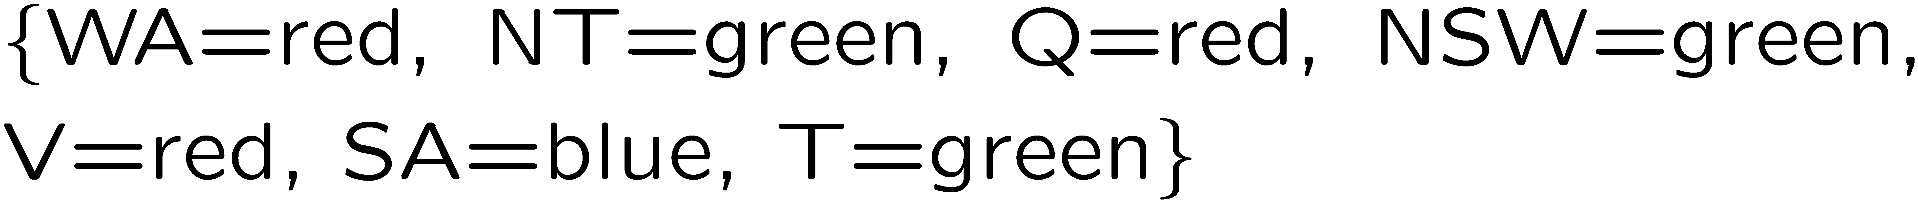
Example: Map Coloring
Variables:
Domains:
Constraints: adjacent regions must have different colors
Solutions are assignments satisfying all constraints, e.g.:
Implicit:
Explicit:

Slide 5

Solving CSPs

Slide 6
Standard Search Formulation
Standard search formulation of CSPs
States defined by the values assigned so far (partial assignments)
Initial state: the empty assignment, {}
Successor function: assign a value to an unassigned variable
Goal test: the current assignment is complete and satisfies all constraints
We’ll start with the straightforward, naïve approach, then improve it

Slide 7
Search Methods
What would BFS do?
What would DFS do?
What problems does naïve search have?
[Demo: coloring -- dfs]
Notes:
Demo:
CS188 javascript demos -> source -> exercises -> csps -> CSPs demos -> CSPs demos.html
Settings:
Graph = Simple
Algorithm = Naïve Search
Ordering = None
Filtering = None

Slide 8

Video of Demo Coloring -- DFS

Slide 9
Video of Demo Coloring -- DFS

Slide 10

Backtracking Search

Slide 11
Backtracking Search
Backtracking search is the basic uninformed algorithm for solving CSPs
Idea 1: One variable at a time
Variable assignments are commutative, so fix ordering
I.e., [WA = red then NT = green] same as [NT = green then WA = red]
Only need to consider assignments to a single variable at each step
Idea 2: Check constraints as you go
I.e. consider only values which do not conflict previous assignments
Might have to do some computation to check the constraints
“Incremental goal test”
Depth-first search with these two improvements
is called backtracking search (not the best name)
Can solve n-queens for n ≈ 25

Slide 12
Backtracking Example

Slide 13
Video of Demo Coloring – Backtracking

Slide 14
Backtracking Search
Backtracking = DFS + variable-ordering + fail-on-violation
What are the choice points?
[Demo: coloring -- backtracking]
Notes:
Demo:
CS188 javascript demos -> source -> exercises -> csps -> CSPs demos -> CSPs demos.html
Settings:
Graph = Simple
Algorithm = Backtracking
Ordering = None
Filtering = None

Slide 15

Improving Backtracking
General-purpose ideas give huge gains in speed
Ordering:
Which variable should be assigned next?
In what order should its values be tried?
Filtering: Can we detect inevitable failure early?
Structure: Can we exploit the problem structure?

Slide 16

Filtering
Keeping track of domains for unassigned variables and cross off bad options

Slide 17
Filtering: Forward Checking
Filtering: Keep track of domains for unassigned variables and cross off bad options
Forward checking: Cross off values that violate a constraint when added to the existing assignment
WA
NT
Q
SA
NSW
V
[Demo: coloring -- forward checking]
Notes:
Demo:
CS188 javascript demos -> source -> exercises -> csps -> CSPs demos -> CSPs demos.html
Settings:
Graph = Simple
Algorithm = Backtracking
Ordering = None
Filtering = Forward Checking

Slide 18
Video of Demo Coloring – Backtracking with Forward Checking

Slide 19
Filtering: Constraint Propagation
Forward checking propagates information from assigned to unassigned variables, but doesn't provide early detection for all failures:
NT and SA cannot both be blue!
Why didn’t we detect this yet?
Constraint propagation: reason from constraint to constraint
NT
Q
WA
SA
NSW
V

Slide 20

Consistency of A Single Arc
An arc X → Y is consistent iff for every x in the tail there is some y in the head which could be assigned without violating a constraint
Forward checking: Enforcing consistency of arcs pointing to each new assignment
NT
Q
WA
SA
NSW
V
Delete from the tail!

Slide 21
Arc Consistency of an Entire CSP
A simple form of propagation makes sure all arcs are consistent:
Important: If X loses a value, neighbors of X need to be rechecked!
Arc consistency detects failure earlier than forward checking
Can be run as a preprocessor or after each assignment
What’s the downside of enforcing arc consistency?
NT
Q
WA
SA
NSW
V
Remember: Delete from the tail!

Slide 22
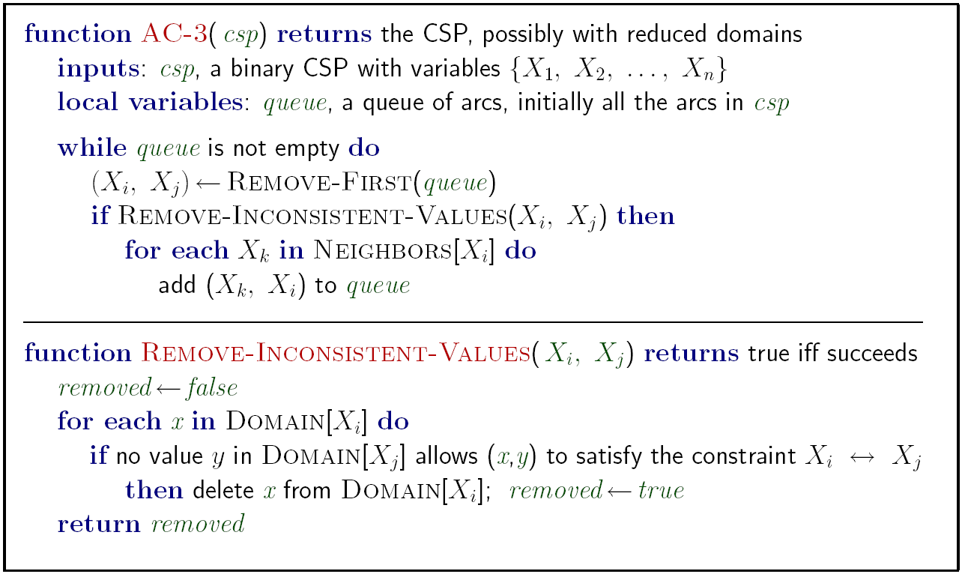
Enforcing Arc Consistency in a CSP
Runtime: O(n²d³), can be reduced to O(n²d²)
… but detecting all possible future problems is NP-hard – why?
[Demo: CSP applet (made available by aispace.org) -- n-queens]
Notes:
Auto-consistency (note initially nothing gets deleted/pruned since there are consistent options for all constraints for initial variable domains)
Flashes whenever something needs to be re-checked

Slide 23
Video of Demo Coloring – Backtracking with Forward Checking – Complex Graph

Slide 24
Video of Demo Coloring – Backtracking with Arc Consistency – Complex Graph

Slide 25
Limitations of Arc Consistency
After enforcing arc consistency:
Can have one solution left
Can have multiple solutions left
Can have no solutions left (and not know it)
Arc consistency still runs inside a backtracking search!
What went wrong here?
[Demo: coloring -- forward checking]
[Demo: coloring -- arc consistency]
Notes:
Demo:
CS188 javascript demos -> source -> exercises -> csps -> CSPs demos -> CSPs demos.html
Settings:
Graph = Complex
Algorithm = Backtracking
Ordering = None
Filtering = Forward Checking (first) / Arc Consistency (second)

Slide 26

K-Consistency

Slide 27
K-Consistency
Increasing degrees of consistency
1-Consistency (Node Consistency): Each single node’s domain has a value which meets that node’s unary constraints
2-Consistency (Arc Consistency): For each pair of nodes, any consistent assignment to one can be extended to the other
K-Consistency: For each k nodes, any consistent assignment to k-1 can be extended to the k^{th} node.
Higher k more expensive to compute
(You need to know the k=2 case: arc consistency)

